Slide 1
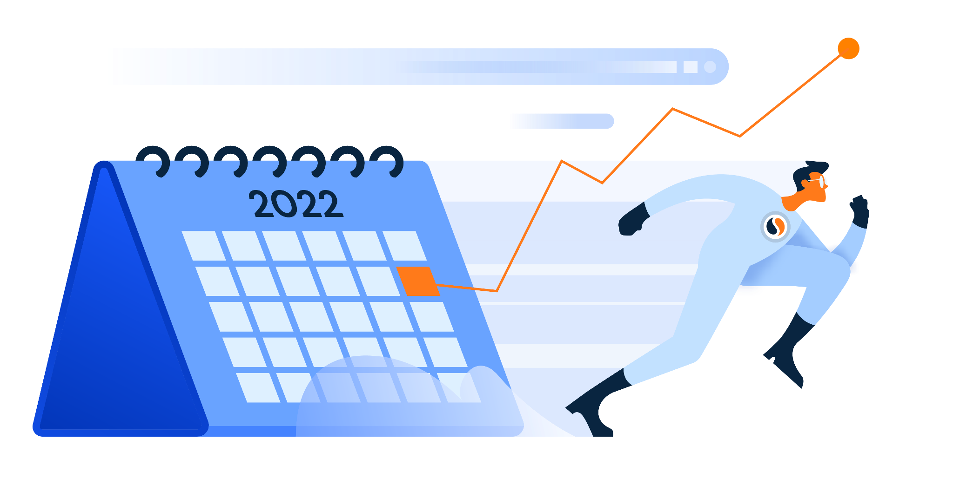

Slide 2
 | Yellow | Orange | Purple
Description How we use our color code | For holidays, both religious and otherwise, and for important days of recognition, such as Indigenous Peoples’ Day. | For sales industry events and conferences. These events typically occur annually and offer important marketing and networking opportunities. | For seasonal marketing opportunities that occur regularly - including social media or unofficial holidays.
Examples of Use | Christmas Eid al-Adha Labor Day Rosh Hashanah Diwali Halloween | DMEXCO OutBound Inbound One-to-One Biarritz | Black Friday International Beer Day Cyber Monday
Color Code

Slide 3
Canada Day
Tour de
France begins
Independence Day (U.S.)
Eid al-Adha
begins
Prime Day
Prime Day
Eid al-Adha
ends
Techspo
Los Angeles
Techspo
Los Angeles
World Emoji
Day
Tour de
France ends
Holidays
Industry events
Seasonal opportunities

Slide 4
International Beer Day
National Nonprofit Day (U.S.)
Holidays
Industry events
Seasonal opportunities

Slide 5
Labor Day
(U.S.)
Inbound
2022
Inbound
2022
Inbound
2022
Inbound
2022
International Literacy Day
SaaStr
Annual
SaaStr
Annual
SaaStr
Annual
OutBound
2022
OutBound
2022
OutBound
2022
OutBound
2022
DMEXCO
DMEXCO
International Day of Peace
Rosh
Hashanah
Rosh
Hashanah
Rosh
Hashanah World Tourism Day
Holidays
Industry events
Seasonal opportunities

Slide 6
Indigenous Peoples’ Day
Canadian Thanksgiving
One-to-One Biarritz
Sales Success Summit
Gartner CSO
& Sales Leader Conference
SaaStock
2022
SaaStock
2022
SaaStock
2022
SaaStock
2022
TechCrunch Disrupt 2022
TechCrunch Disrupt 2022
TechCrunch Disrupt 2022
Diwali
Halloween
Holidays
Industry events
Seasonal opportunities

Slide 7
Web Summit
Web Summit
Web Summit
Web Summit
Ascent Annual
Ascent Annual
Sales Innovation Expo
Thanksgiving
Black Friday
Small Business Saturday
Cyber Monday
Holidays
Industry events
Seasonal opportunities

Slide 8
Digital Summit Chicago
Digital Summit Chicago
Hanukkah
begins
Christmas Eve
Christmas Day
Boxing Day
Kwanzaa begins
Hanukkah ends
New Year’s Eve
Holidays
Industry events
Seasonal opportunities

